Slide 1
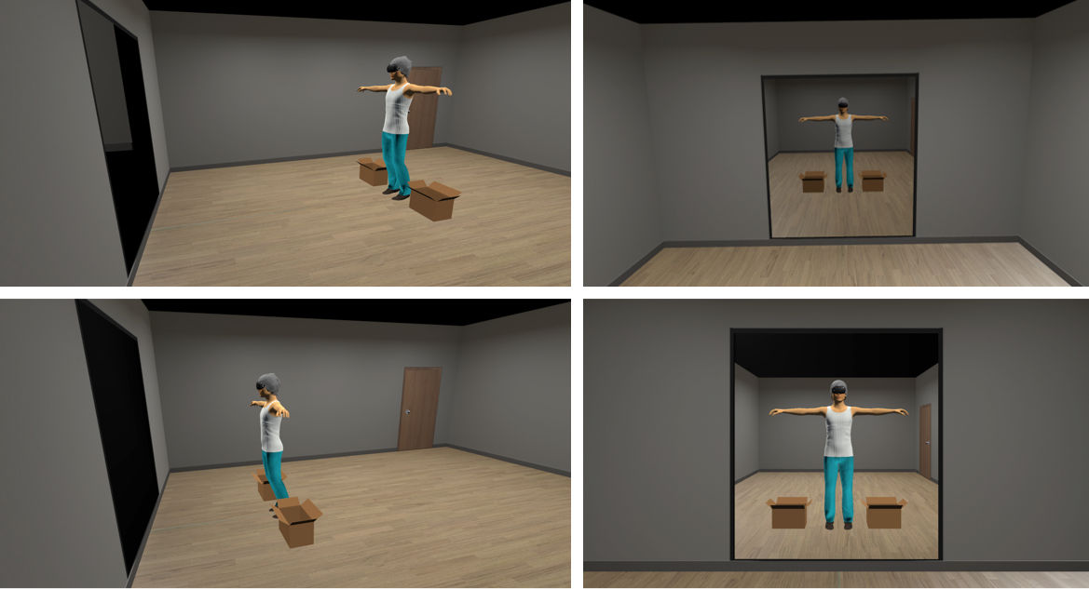
Mirror exposure therapies: effect of the distance to the mirror on the attentional pattern in a virtual reality immersive environment.
EPP0608
Franck-Alexandre Meschberger-Annweiler ^{1, *}, Mariarca Ascione ¹, Bruno Porras-Garcial ², Helena Miquel ¹, Erik Exposito ¹, Eduardo Serrano-Troncoso ³, Marta Carulla-Roig ³, Marta Ferrer-Garcia ¹, Jose Gutierrez-Maldonado ¹
¹ Department of Clinical Psychology and Psychobiology and Institute of Neurosciences, University of Barcelona, Barcelona, Spain;
² Department of Population Health Science, University of Utah School of Medicine, Salt Lake City, United States;
³ Child and Adolescent Psychiatry and Psychology Department, Hospital Sant Joan de Déu of Barcelona, Esplugues de Llobregat, Spain;
* Correspondence: franck.meschberger@ub.edu
HIGHLIGHTS:
This study shows new opportunities to use Virtual Reality and Eye-Tracking technologies to precisely analyse the variations of attentional patterns as a function of mirror position in mirror exposure therapies (MET).
Such information may contribute to adapt and develop new MET’s protocols for patients with anorexia nervosa, optimizing the distance to the mirror.
It also underscores the importance of specifying the distance to the mirror in MET-related studies to improve replicability.
Results: Independent Samples t-Test shows statistically significant CFT mean difference (F (1, 135) = 1.571, p < 0.001, 95% IC [1717; 5581]) between both groups. Effect size is in the medium range (Hedge’s g = .65) (see table 1).
Methods: 137 female college students were immersed in a VR environment in which they could look in the mirror at their respective avatars created from the measurements and photos of their real bodies. The mirror was positioned at 3.30m in front of the participants in “group 1” (n₁ = 54), and at 1.54m in front of the participants in “group 2” (n₂ = 83) (see figure 1).
Table 1::
CFT mean and standard desviation
by group
(a)
Conclusion: The attentional pattern of the group positioned further to the mirror (3.30m in group 1) was significantly more focused on weight-related body parts, than that of the group positioned closer to the mirror (1.54m in group 2) (see examples in figure 3)
Introduction: Mirror exposure therapies (MET) have been proposed to reduce symptomatology in patients with eating disorders through habituation process (e.g., [1,2]). However, most MET protocols or related studies do not specify the patients’ distance to the mirror, or when they do so, such a distance may differ significantly (usually from 0,5 to 3 meters). Such modifications of mirror positioning could imply variations in patients’ fixation patterns on different body parts (i.e., attentional bias between weight-related and non-weight related body parts), since previous studies shown that dissociated neural systems (either in left or right cerebral hemispheres) are involved in the attentional patterns and scanning strategies depending on the distance (i.e., in near and far space) [3]. Furthermore, as the body-related attentional bias has been shown to be a part of the maintenance mechanism of anorexia nervosa symptomatology [4,5], any modification of attentional patterns due to mirror’s distance variations may influence the efficacy of MET.
(b)
Figure 2: Weight-related (in yellow) and non-weight-related- (in blue) body parts from PASTAS questionnaire
Figure 3: Examples of attentional patterns more focused on
(a) weight-related body parts (group 1,.3.30m; CFT > 0);
(b) non-weight-related body parts (group 2, 1.54m; CFT < 0).
Figure 1: Front and profile views of avatar positioning with different distances to the mirror: (a) 3.30 m in group 1; (b) 1.54 m in group 2.
(a)
(b)
Tobii® Eye-Tracking feature of the VR Head-Mounted Display HTC VIVE PRO EYE® and OGAMA software (Freie Universität, Berlin, Germany) were used to record and process the attentional pattern of each participant, during a 30-second free viewing task at her avatar.
Complete Fixation Time (CFT) was assessed as the fixation time difference between weight- and non-weight-related body parts, defined from the weight scale of the PASTAS questionnaire [6] (see figure 2):
$$CFT=Fixation time Weight AOIs−Fixation timeNon weight AOIs$$
Objectives: This study aims to use Virtual Reality (VR) and Eye-Tracking (ET) technologies to precisely analyse the effect of the distance to the mirror on the attentional patterns.
Funding: This study was funded by the Spanish Ministry of Science and Innovation, Grant PID2019-108657RB-I00 funded by MCIN/AEI/ 10.13039/501100011033.This study also has the support of “Fundació La Marató de TV3”, Grant 202217-10.
References:
[1] Delinsky SS, & Wilson, GT. (2006). https://doi.org/10.1002/eat.20207
[2] Hildebrandt T, et al. (2012). https://doi.org/10.1016/j.brat.2012.09.004
[3] Varnava A, et al. (2002). https://doi.org/10.1016/S0028-3932(01)00204-4
[4] Tuschen-Caffier B, et al. (2015). https://doi.org/10.1371/journal.pone.0145886
[5] Bauer A, et al. (2017). https://doi.org/10.1007/s10802-017-0263-z
[6] Reed DL, et al. (1991). https://doi.org/10.1016/0887-6185(91)90032-O

